Slide 1
Chapter 8: Arrays

Slide 2
Objectives
Declare arrays
Initialize an array
Use variable subscripts with an array
Declare and use arrays of objects
Search an array and use parallel arrays
Pass arrays to and return arrays from methods
Java Programming, Seventh Edition

Slide 3
Declaring Arrays
Array
  A named list of data items
  All data items have the same type
Declare an array variable
  The same way as declaring any simple variable
  Insert a pair of square brackets after the type
double[] salesFigure;
int[] idNums;
Java Programming, Seventh Edition

Slide 4
Declaring Arrays (cont’d.)
Still need to reserve memory space
  sale = new double[20];
  double[] sale = new double[20];
Subscript
  An integer contained within square brackets
  Indicates one of the array’s variables or elements
  A subscript that is too small or too large for an array is out of bounds
    An error message is generated
Java Programming, Seventh Edition

Slide 5
Declaring Arrays (cont’d.)
An array’s elements are numbered beginning with 0
  You can legally use any subscript from 0 through 19 when working with an array that has 20 elements
When working with any individual array element, treat it no differently than a single variable of the same type
  Example: sale[0] = 2100.00;
Java Programming, Seventh Edition

Slide 6
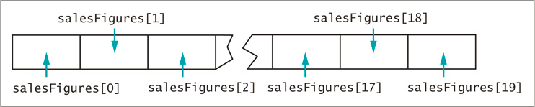
Declaring Arrays (cont’d.)
Figure 8-1 The first few and last few elements of an array of 20 salesFigures items in memory
Java Programming, Seventh Edition

Slide 7
Initializing an Array
A variable with a reference type, such as an array, holds a memory address where a value is stored
Array names:
  Represent computer memory addresses
  Contain references
When you declare an array name:
  No computer memory address is assigned
  The array has the special value null
    Unicode value ‘\u0000’
Java Programming, Seventh Edition

Slide 8
Initializing an Array (cont’d.)
Use the keyword new to define an array
  The array name acquires the actual memory address value
int[] someNums = new int[10];
  Each element of someNums has a value of 0
char array elements
  Assigned ‘\u0000’
boolean array elements
  Automatically assigned the value false
Strings and arrays of objects
  Assigned null by default
Java Programming, Seventh Edition

Slide 9
Initializing an Array (cont’d.)
Assign nondefault values to array elements upon creation
  int[] tenMult = {10, 20, 30, 40, 50, 60};
An initialization list initializes an array
  Values are separated by commas and enclosed within curly braces
Populating an array
  Providing values for all the elements in an array
Java Programming, Seventh Edition

Slide 10
Using Variable Subscripts with an Array
Scalar
  A primitive variable
Power of arrays
  Use subscripts that are variables rather than constant subscripts
  Use a loop to perform array operations
  for (sub = 0; sub < 5; ++sub)
    scoreArray[sub] += 3;
Java Programming, Seventh Edition

Slide 11
Using Variable Subscripts with an Array (cont’d.)
When an application contains an array:
  Use every element of the array in some task
  Perform loops that vary the loop control variable
    Start at 0
    End at one less than the size of the array
It is convenient to declare a symbolic constant equal to the size of the array
  final int NUMBER_OF_SCORES = 5;
Java Programming, Seventh Edition

Slide 12
Using Variable Subscripts with an Array (cont’d.)
Field
  An instance variable
  Automatically assigned a value for every array created
length field
  Contains the number of elements in the array
  for(sub = 0; sub < scoreArray.length; ++sub)
    scoreArray[sub] += 3;
length is a property of the object
  Is a field
  Cannot be used as an array method
Java Programming, Seventh Edition

Slide 13
Using Variable Subscripts with an Array (cont’d.)
Enhanced for loop
  Allows you to cycle through an array without specifying starting and ending points for the loop control variable
  for(int val : scoreArray)
    System.out.println(val);
Java Programming, Seventh Edition

Slide 14
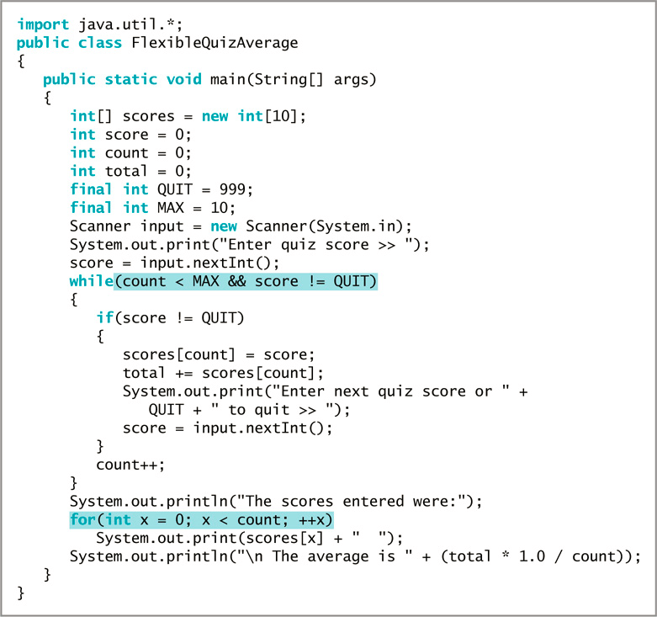
Using Part of an Array
In cases when you do not want to use every value in an array
Figure 8-4 The FlexibleQuizAverage application
Java Programming, Seventh Edition

Slide 15
Declaring and Using Arrays of Objects
Create an array of Employee objects
  Employee[] emp = new Employee[7];
  Must call seven individual constructors
  final double PAYRATE = 6.35;
  for(int x = 0; x < NUM_EMPLOYEES; ++x)
    emp[x] = new Employee(101 + x, PAYRATE);
Java Programming, Seventh Edition

Slide 16
Using the Enhanced for Loop with Objects
Use the enhanced for loop to cycle through an array of objects
  Eliminates the need to use a limiting value
  Eliminates the need for a subscript following each element
  for(Employee worker : emp)
  System.out.println(worker.getEmpNum() + " " + worker.getSalary();
Java Programming, Seventh Edition

Slide 17
Manipulating Arrays of Strings
Create an array of Strings
  String[] deptNames = {"Accounting", "Human Resources", "Sales"};
  for(int a = 0; a < deptNames.length; ++a)
    System.out.println(deptNames[a]);
Java Programming, Seventh Edition

Slide 18
Searching an Array and Using Parallel Arrays
Determine whether a variable holds one of many valid values
  Use a series of if statements
  Compare the variable to a series of valid values
Java Programming, Seventh Edition

Slide 19
Searching an Array and Using Parallel Arrays (cont’d.)
Searching an array
  Compare the variable to a list of values in an array
  for(int x = 0; x < validValues.length; ++x)
  {
    if(itemOrdered == validValues[x])
      validItem = true;
  }
Java Programming, Seventh Edition

Slide 20
Using Parallel Arrays
Parallel array
  One with the same number of elements as another
  The values in corresponding elements are related
An alternative for searching
  Use the while loop
Java Programming, Seventh Edition

Slide 21
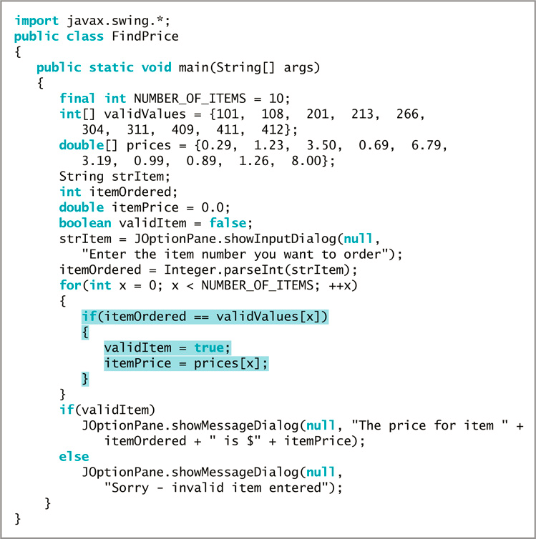
Using Parallel Arrays (cont’d.)
Figure 8-9 The FindPrice application that accesses information in parallel arrays
Java Programming, Seventh Edition

Slide 22
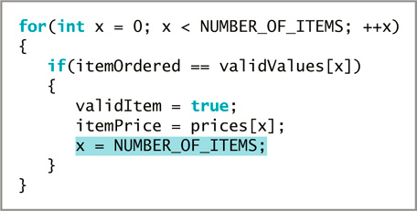
Using Parallel Arrays (cont’d.)
Figure 8-11 A for loop with an early exit
Java Programming, Seventh Edition

Slide 23
Searching an Array for a Range Match
Searching an array for an exact match is not always practical
Range match
  Compare a value to the endpoints of numerical ranges
  Find the category in which a value belongs
Java Programming, Seventh Edition

Slide 24
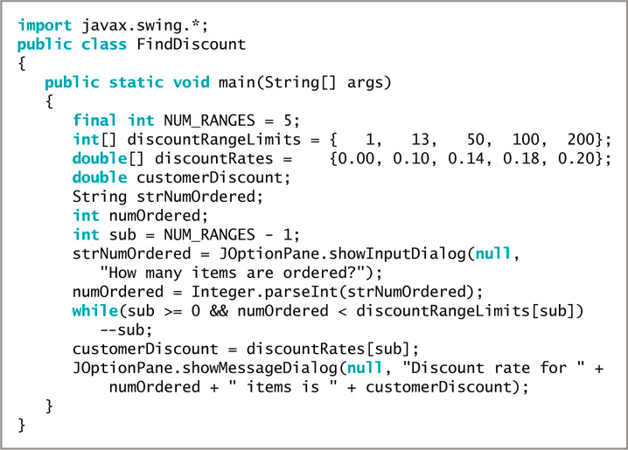
Figure 8-13 The FindDiscount class
Java Programming, Seventh Edition

Slide 25
Passing Arrays to and Returning Arrays from Methods
Pass a single array element to a method
  Same as passing a variable
Passed by value
  A copy of the value is made and used in the receiving method
  All primitive types are passed this way
Java Programming, Seventh Edition

Slide 26
Passing Arrays to and Returning Arrays from Methods (cont’d.)
Reference types
  The object holds a memory address where the values are stored
  The receiving method gets a copy of the array’s actual memory address
  The receiving method has the ability to alter the original values in array elements
Java Programming, Seventh Edition

Slide 27
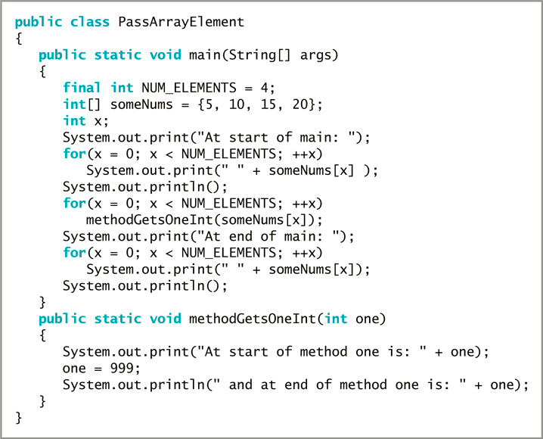
Figure 8-16 The PassArrayElement class
Java Programming, Seventh Edition

Slide 28
Returning an Array from a Method
A method can return an array reference
Include square brackets with the return type in the method header
Java Programming, Seventh Edition

Slide 29
You Do It
Declaring an Array
Initializing an Array
Using a for Loop to Access Array Elements
Creating a Class That Contains an Array of Strings
Searching an Array
Passing an Array to a Method
Java Programming, Seventh Edition

Slide 30
Don’t Do It
Don’t forget that the lowest array subscript is 0
Don’t forget that the highest array subscript is one less than the length
Don’t forget the semicolon following the closing curly brace in an array initialization list
Don’t forget that length is an array property and not a method
Don’t place a subscript after an object’s field or method name when accessing an array of objects
Java Programming, Seventh Edition

Slide 31
Don’t Do It (cont’d.)
Don’t assume that an array of characters is a string
Don’t forget that array names are references
Don’t use brackets with an array name when you pass it to a method
Java Programming, Seventh Edition

Slide 32
Summary
Array
  A named list of data items
  All have the same type
Array names
  Represent computer memory addresses
Shorten many array-based tasks
  Use a variable as a subscript
length field
  Contains the number of elements in an array
Java Programming, Seventh Edition

Slide 33
Summary (cont’d.)
You can declare arrays that hold elements of any type, including Strings and other objects
Search an array to find a match to a value
Perform a range match
Pass a single array element to a method
Java Programming, Seventh Edition

Slide 34
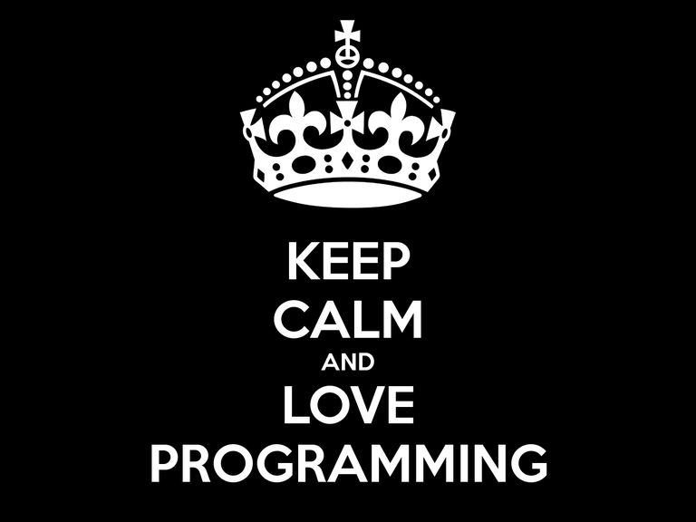

Java Programming, Seventh Edition

